Slide 1

Derry Hill Primary School
Welcome to Rabbit Class
Thank you for coming

Slide 2
About me
Derry Hill Primary School

Slide 3
Our daily routine
Derry Hill Primary School
GMA (Good morning activity) – SPAG/ Maths (TT focus)/ Mindfulness
Writing
Reading
Break
Maths
Lunch
Foundation subjects (Geography/History/Computing/Music/Art/DT/Spanish/PE/PSHE/RE)

Slide 4
Writing
Derry Hill Primary School
In writing we are basing our units of work off award winning texts, multi-media resources and videos (both fiction and non-fiction). Using the literacy tree SoW.
Teaching and learning is split between 3 styles of lessons;
1) Experience days - where children are immersed in sections of the text through - Drama, DT, Art etc.
2) Shared pieces of writing - where children will be scaffolded and supported to reach Year writing objectives
3) Independent extended writes - where children will showcase their writing skills in various formats.

Slide 5
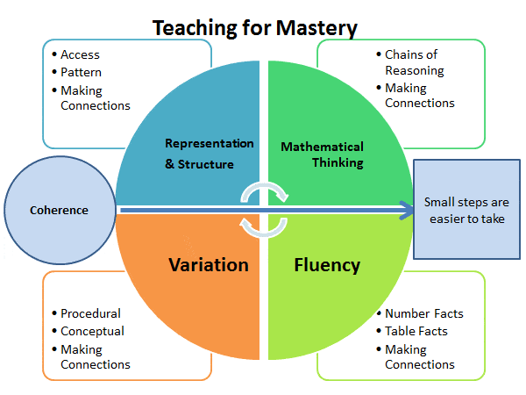
Maths
Derry Hill Primary School
A culture we are establishing within our classroom is a mastery approach to Maths.
This means that children will a develop deep understanding of maths rather than being able to memorise key procedures or resort to rote learning.
The research behind this states that children will be able to apply and transfer their knowledge across different disciplines.

Slide 6
Derry Hill Primary School
Expectations in the classroom and work
A couple of key words/phrases children will become familiar with over the next couple of weeks…‘growth mindset’ ‘independent’ ‘Year 4 expectations’
In repeating these phrases I am trying to inspire an ethos around the classroom in which children see challenges as opportunities to grow and give their best in everything that they do.
Following of the school rules and being role models for the rest of the school

Slide 7
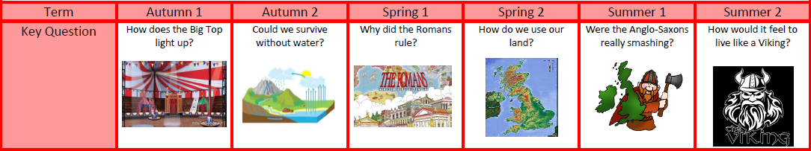
Topics for the year
Derry Hill Primary School

Slide 8
Homework
Derry Hill Primary School
Homework will be set on Mondays and checked the following week, homework will be a combination of spelling, reading, writing and maths.
Spelling – sent home on Monday and ready for testing the following Monday.
Reading – 4 times a week and recorded in reading records earns a gold coin.
TTRS – 4 times a week earns a gold coin.
Doddle learning 20 minutes of writing work and 20 minutes of maths work earns a gold coin.

Slide 9
Multiplication tables check (MTC)
The multiplication tables check (MTC) is statutory for all year 4 pupils registered at state-funded maintained schools, special schools or academies, including free schools, in England. Schools must provide a reason for any pupils who do not participate in the check.
The purpose of the MTC is to determine whether pupils can recall their times tables fluently up to 12, through a set of 25 timed questions. This skill is essential for future success in mathematics, and the check will help schools identify pupils who have not yet mastered this and provide additional support.
Schools must administer the MTC during a scheduled 2-week period in June

Slide 10
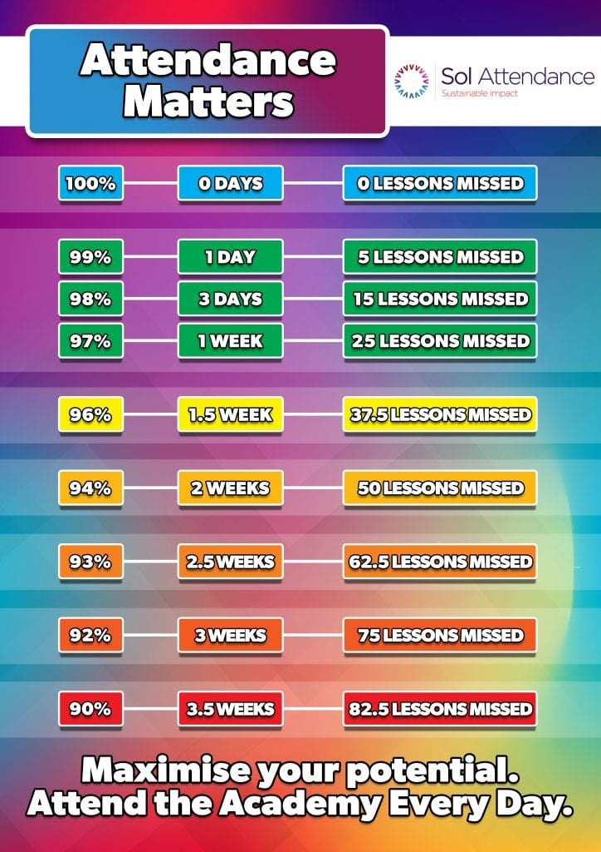
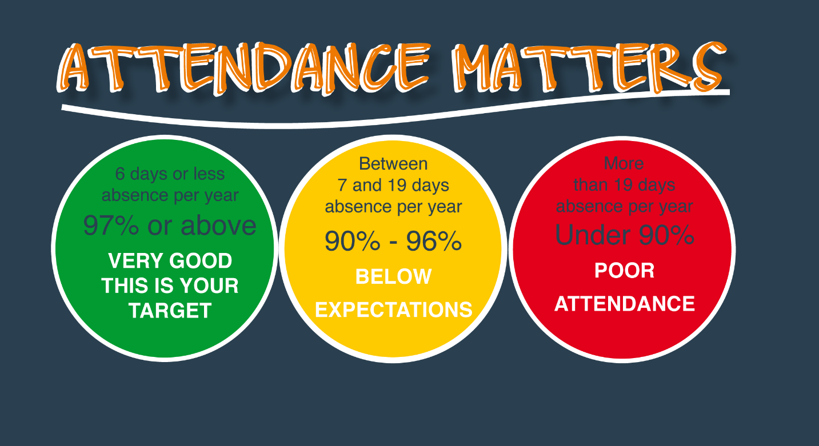
Attendance
Derry Hill Primary School

Slide 11
Administrative news for term 1
Derry Hill Primary School
PE will be on Wednesday and Thursday and Wednesday.
Harvest Festival 24/09/26
Individual photos 08/10/26

Slide 12
Any Questions?
Derry Hill Primary School

