Slide 1

Derry Hill Primary School
Welcome to Owl Class
Thank you for coming

Slide 2

MEET THE OWL CLASS TEAM
Mrs Shears – Monday – Thursday
Mrs Asfaw – Fridays
Mrs Hubbard – HLTA/ELSA

Slide 3
Our daily routine
Derry Hill Primary School
EMT (Early Morning Task)
Reading
Writing
Break
Maths
Lunch
Foundation subjects (Geography/History/Computing/Music/Art/DT/Spanish/PE/PSHE/RE)
Act of Worship

Slide 4
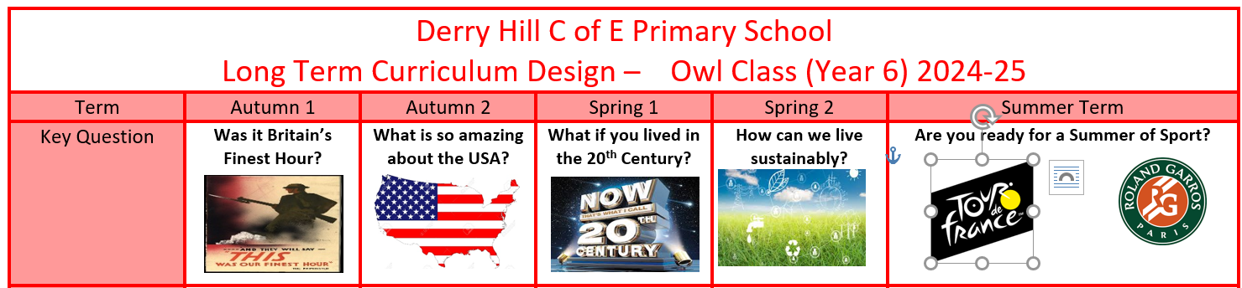
Topics for the year
Derry Hill Primary School
Planning and Knowledge Organisers
https://www.derryhillschool.co.uk/page/?title=Year+6+%2D+Owl&pid=38

Slide 5
Homework
Derry Hill Primary School
Homework will be set on Thursdays and handed in the following Monday
Homework will be a combination of spelling, reading, writing and maths (this will begin after October half-term)
CGP books will be used as homework to support with revision in the build up to SATs.
Spelling – sent home on Monday and ready for testing the following Monday.
Reading – 5 times a week and recorded in reading records earns a gold coin.
TTRS – please continue to use this

Slide 6
SATs
In 2027, Year 6 SATs week will take place on the week beginning Monday 10th May and end on Thursday 13th May.
The children will complete 6 tests: Reading, SPAG, Spelling, Arithmetic 1, Reasoning 2, Reasoning 3.
.
A meeting will be held about SATs at a date closer to the time.
Children will have regular exposure to these tests throughout the year to gain confidence and understand the process with SATS.
BASELINE TESTS HAPPENING THIS WEEK AND A FURTHER TWO OR 3 SATS TESTS THROUGHOUT THE YEAR

Slide 7
Residential
Residential this year will be the week before May Half-term (week beginning 24/05/26)
More details and a meeting will be held at a date closer to the time.

Slide 8
Administrative news for term 1
Derry Hill Primary School
PE in term 1 will be on Monday and Wednesday.
Head boy and girl presentations - Wednesday 16th September. Please email any presentations to admin@derryhill.wilts.sch.uk
Harvest Festival – Thursday 24th September at 9:15
Owl Class Family Learning Afternoon – Tuesday 20th October at 2:00

Slide 9
Any Questions?
Derry Hill Primary School

