Slide 1
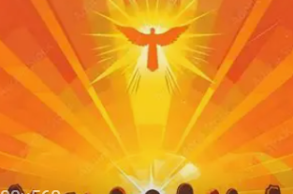
The Ascension and Pentecost
LI: I can compare how different people describe the Holy Spirit.
Key Words:
disciples
Ascension
Pentecost
Holy Spirit
fire
dove
tongues (languages)
baptised
Success Criteria:
I can identify key symbols on works of art.
I can create my own piece of art showing how the Holy Spirit appeared to the disciples.

Slide 2
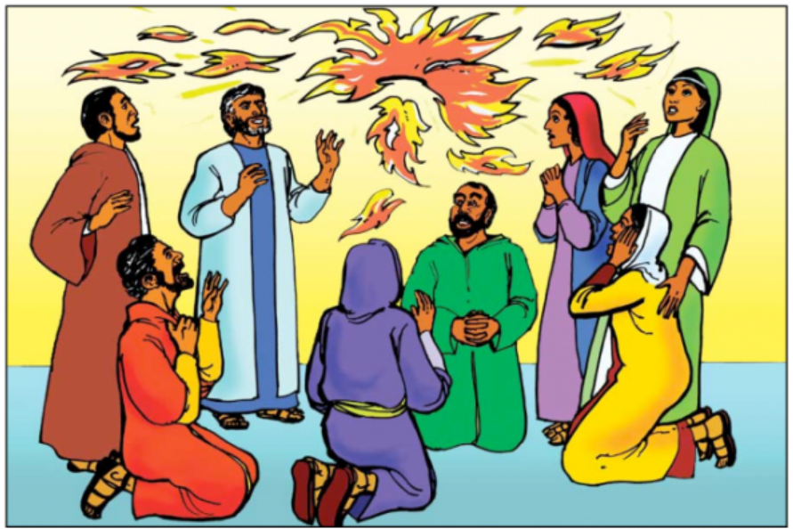
Last lesson we watched this video explaining Pentecost.
Watch it again. How was the Holy Spirit described in the story?
Pentecost Explained in 3 Minutes (with puppets!)

Slide 3
Look at the art work that has been done about this story by lots of different types of artists.
Can you say how they have each shown the Holy Spirit in the pictures?
Which is your favourite picture and why?
Pentecost Explained in 3 Minutes (with puppets!)

Slide 4
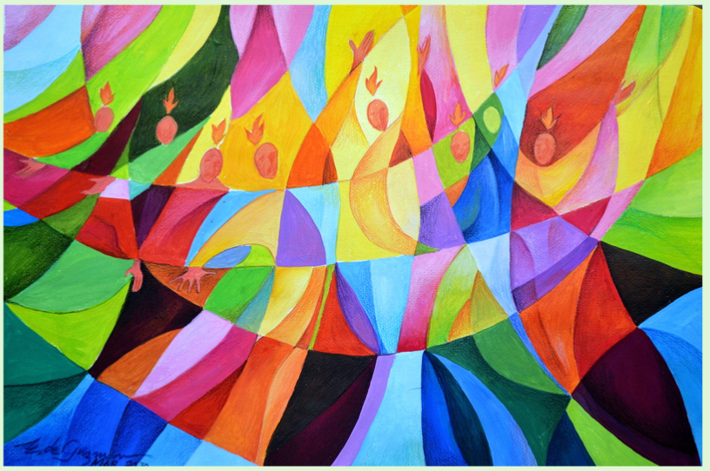
Pentecost Art:
Edgardo de
Guzman

Slide 5
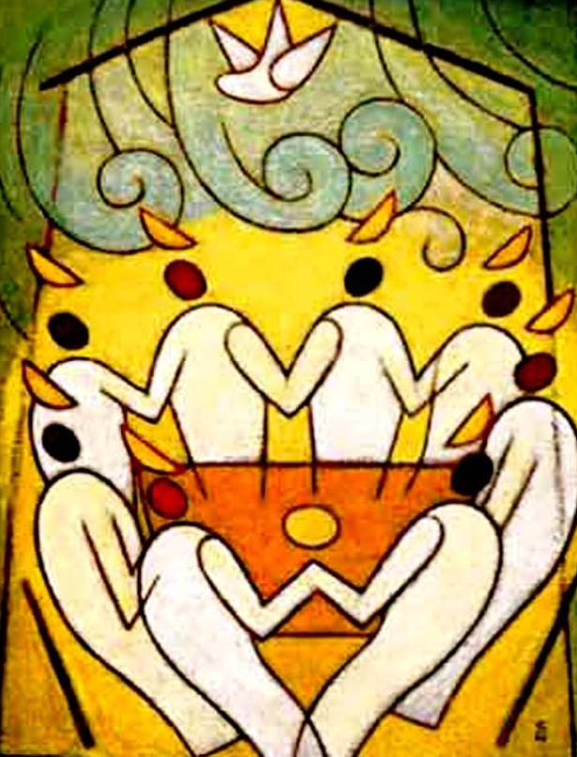
Pentecost Art:
Soichi Watanabe

Slide 6
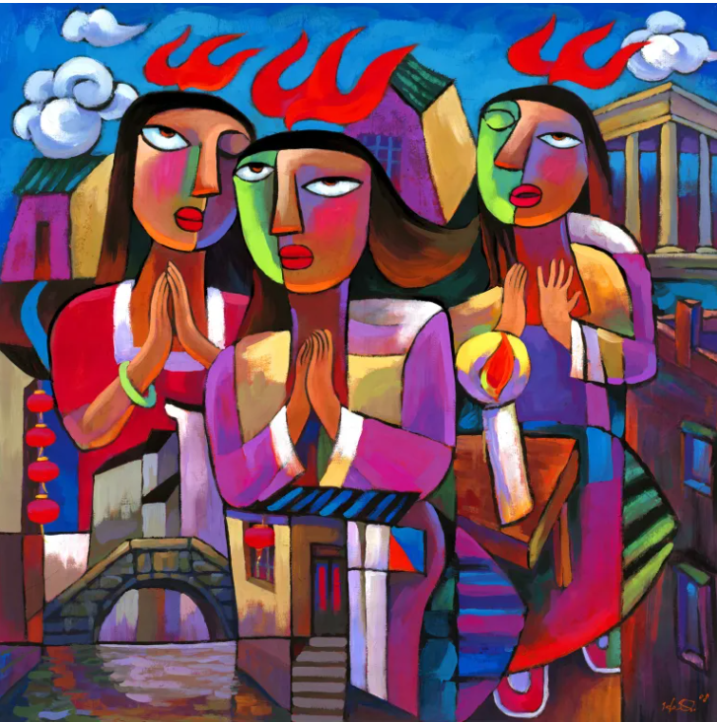
Pentecost Art:
He Qi

Slide 7
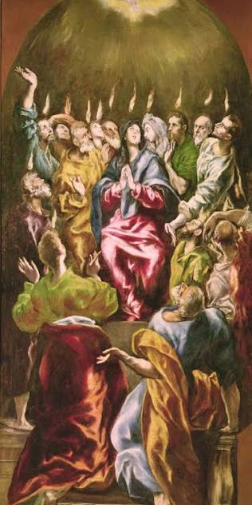
Pentecost Art:
El Greco

Slide 8
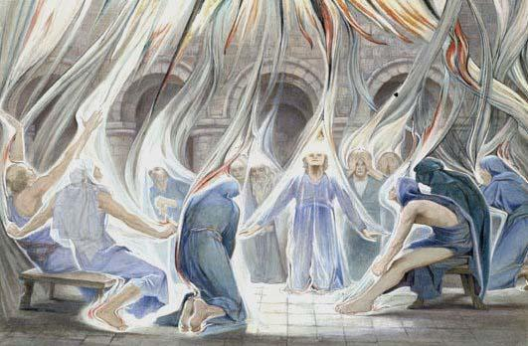
Pentecost Art:
Estella Louisa M Canziani.

Slide 9
Create your own piece of art-work showing Pentecost.
It does not have to be realistic, but should show how amazing the disciples felt when the Holy Spirit came on them.
Pentecost Explained in 3 Minutes (with puppets!)

