Slide 1


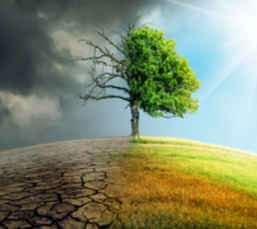
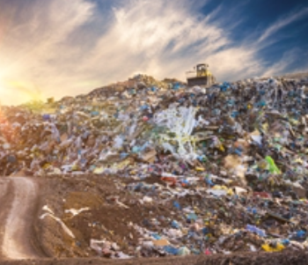
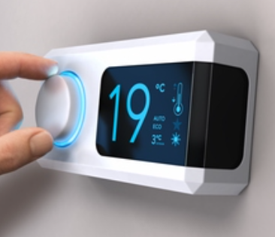
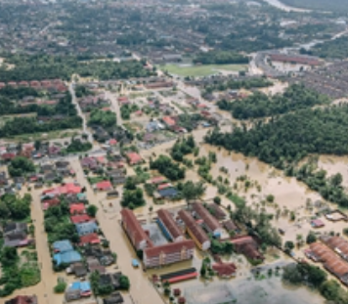
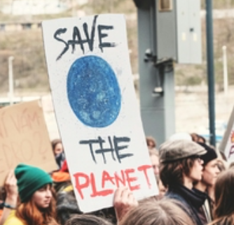
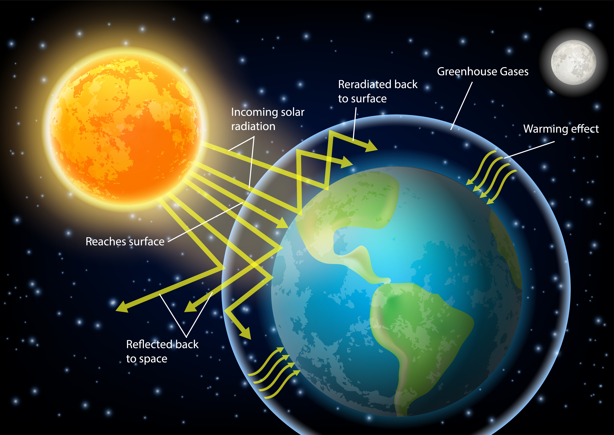
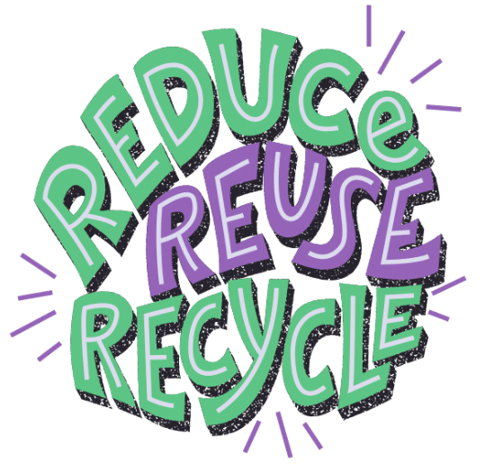
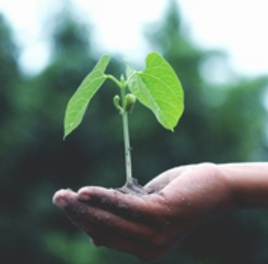
Knowledge Organiser
Year 6 – Looking after our
environment
Careers connected to Looking after our environment:
Environmental engineer, climate scientist, wildlife conservationist, aid worker
Lesson Sequence
Greenhouse Gases
Some human activities produce greenhouse gases (carbon dioxide, methane, nitric oxide):
Cutting down trees means more carbon dioxide stays in the air.
Farming animals produces methane gas.
Transport – fuels such as diesel and petrol produce carbon dioxide.
Energy production: burning non-renewable sources such as coal, oil and gas produces greenhouse gases.
Climate Change
Greenhouse gases trap the heat from
the sun and stop it leaving the Earth, causing the planet to become warmer.
A warmer planet means the ice caps are melting, are there is more flooding, heatwaves and droughts.
Energy Sources
1. Learn about climate change
Renewable | Non-renewable
Wind Solar Hydropower | Oil Coal Gas Nuclear power stations
2. Explore ways to reduce how much rubbish is sent to landfill
How we can help
Recycle as much rubbish as possible so factories don’t have to use coal and oil to make new products.
Buy products with recyclable packaging.
Switch off lights and electrical appliances when not in use.
Walk, cycle or car share.
Use renewable energy sources for power if possible.
Plants more trees as they use carbon dioxide to make food, so this helps
reduce the amount in the
atmosphere.
Eat less meat so fewer
animals (who produce
methane) are farmed.
3. Explore ways to reduce energy consumption
4. Explore how climate change affects our planet
5. Explore what is being done to reduce climate change
6. Explore how data can demonstrate climate change
1
Developing Experts Copyright 2025 All Rights Reserved

Slide 2

Knowledge Organiser
Year 6 – Looking after our
environment
Careers connected to Looking after our environment:
Environmental engineer, climate scientist, wildlife conservationist, aid worker
Rocket Words
climate change | change in the Earth's usual weather conditions over many years
global warming | the process that causes the Earth to become hotter
greenhouse gases | gases in the Earth's atmosphere that trap heat
recycle | the process of taking waste materials and turning them into something new as opposed to being thrown away
emissions | things that are sent out into the air, like gases from cars and factories
renewable | a resource which can be used repeatedly because it is replaced naturally
non-renewable | a resource which cannot be used repeatedly
net zero | the balance between how much greenhouse gas we add to the environment and what is taken away
2
Developing Experts Copyright 2025 All Rights Reserved

