Slide 1
Year 6 Residential
To Ultimate Adventure Centre , North Devon
18th – 22nd May 2026

Slide 2
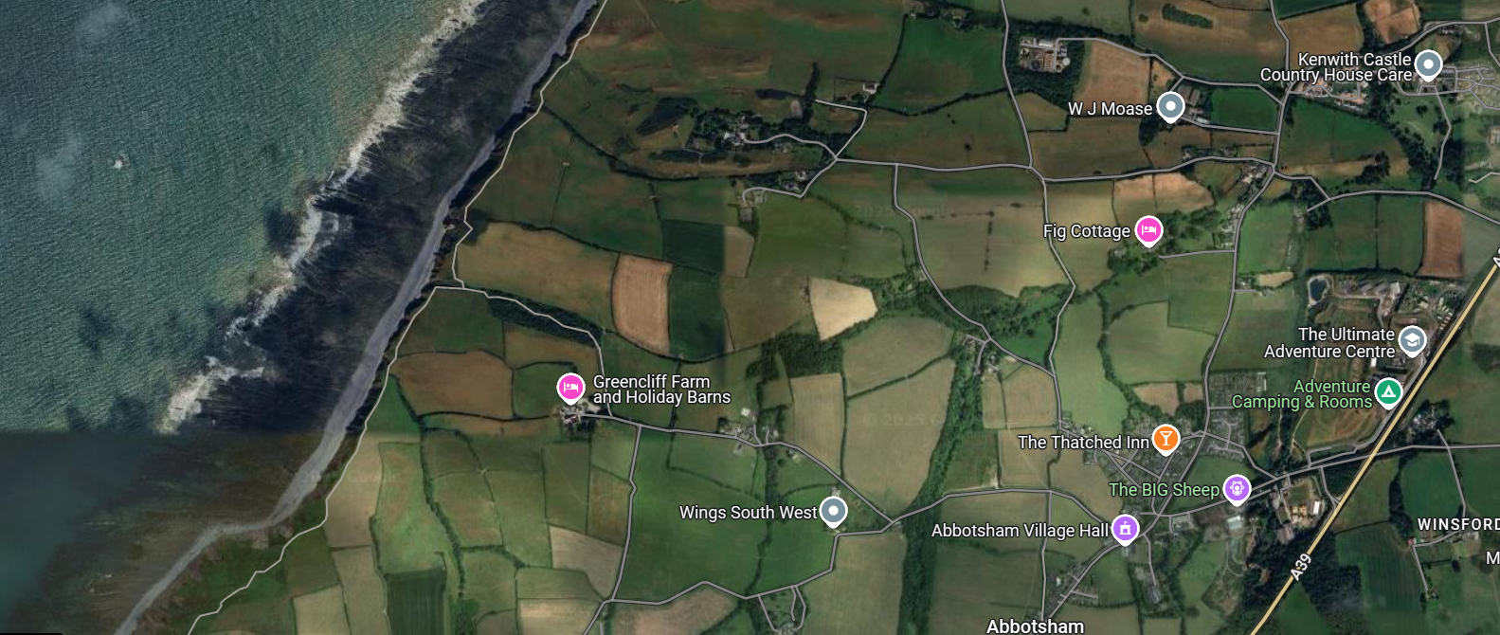
Ultimate Adventure - North devon
Ultimate Adventure North Devon is set amongst the beautiful hillsides of Abbotsham, just a short drive from Bideford town centre and Westward Ho! Beach. A perfect site to enjoy coastal views, rolling hills and countryside while experiencing a sense of adventure.

Slide 3
Important timings
Departure
Leave school at 8.30am on Monday 18th May – children to arrive in school from 8.am – please leave your child’s luggage outside along the fence.
Arrive at Bideford at 12.30pm.
Children will need a packed lunch – please put all food in disposable bags / containers that can be thrown away.
Return
Leave North Devon at 1pm on Friday 22nd May arriving back at school at approx. 4pm (we will keep you updated of the ETA).

Slide 4
Accommodation
The accommodation contains 3 teacher rooms and 6 children’s rooms. The children will be allocated in a room with approximately 4/5 children.
Children have been asked to write down those they would like to be with and we will always endeavour to put children with at least 1 friend that they requested. As you can imagine it is a very difficult task trying to please everyone.
Children will not find out who they are with until they arrive.

Slide 5
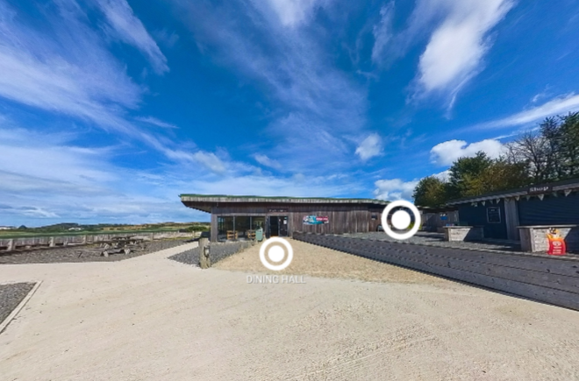

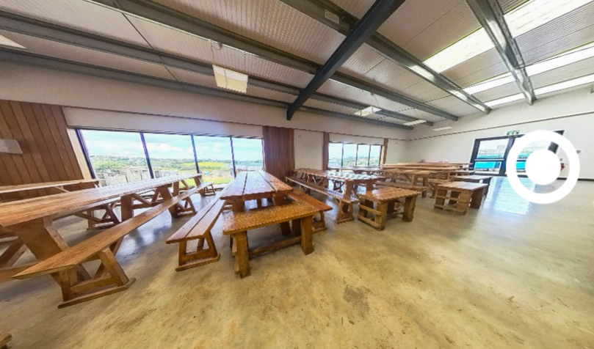
food

Slide 6
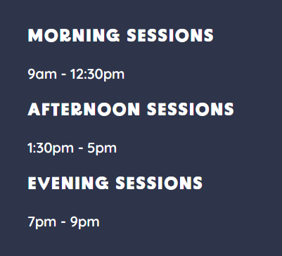
Activities
All activity sessions are led by specialist trained staff.
Activities that we will be doing during the week include:
High ropes, buggy boarding, surfing, kayaking, archery, ultimate assault course and a visit to the Big Sheep to name just a few.
There will be a total of 16 activities keeping the children busy.

Slide 7
What to take
Kit list have been provided so please ensure your child takes the items suggested on the kit list. Bedding is provided – this makes things much easier!
Please do not pack:
Mobile phones or electronic devices (if any are found these will be confiscated and given back to parents on return to school).
Sweets, crisps or drinks.
Pocket Money
Children are able to take £10 maximum. Please ensure this is secured safely in a purse / wallet. Spending money is the responsibility of the child.

Slide 8
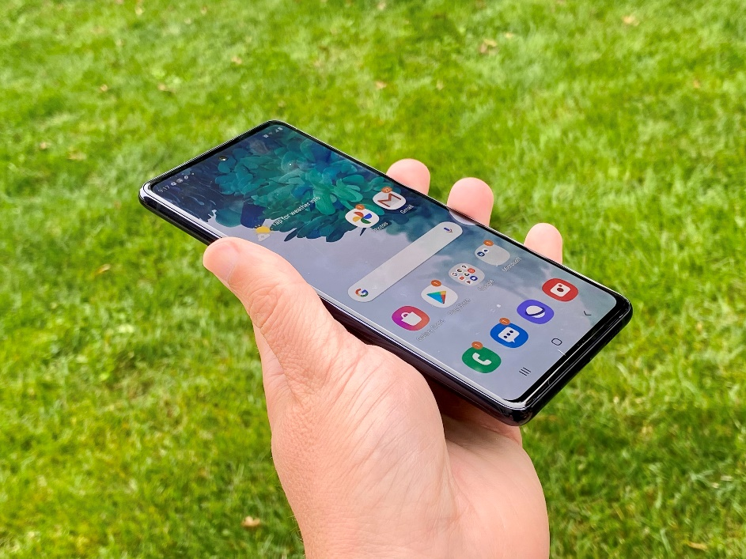
Communication
We will endeavour to provide updates to parents via ParentMail – signal permitting.
Please bear in mind that the staff are engaged in the activities throughout the day so have very little time to communicate with school.
No news should be considered good news!

Slide 9
Medications
All prescribed medications for the residential trip need to be in by Friday 9th May 2025. Please hand this into the office.
With permission (on the consent form) staff are able to give Calpol for minor ailments.
If your child is travel sick please make sure they are given medication before school on the Monday and don’t forget to give us medication for the return journey.

Slide 10

Questions

