Slide 1

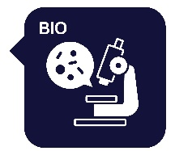
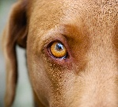
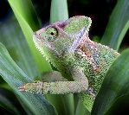
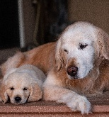
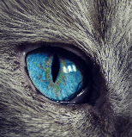


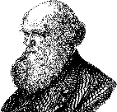

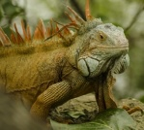
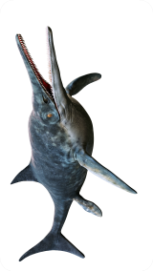
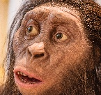
Knowledge Organiser
Year 6 – Evolution & Inheritance
Careers connected to Evolution and Inheritance: geneticist, DNA analyst, biological Researcher, conservationist
Lesson Sequence
Characteristics and variation
A characteristic describes how something looks or how it behaves. Characteristics can be passed on from parents to their offspring, meaning that they can be inherited. They can include hair colour, eye colour and height. Environmental factors can also affect a person’s characteristics
Adaptations
Plants and animals have numerous adaptations which help them to survive in their habitats.
Camels have humps to store food, two rows of eyelashes and small slits for nostrils
Epiphytes are plants which can grow on the surface of another plant
Some plants contain toxic minerals to protect themselves from predators
Other plants can store water, trap insects and smother other plants
Charles Darwin, the Galapagos Islands and human evolution
Charles Darwin was a famous naturalist who studied finches and tortoises on the Galapagos Islands. He suggested that some species may share a common ancestor and evolve to suit their habitats. Those who cannot adapt to their environment become extinct. He called this process natural selection. Humans have also gone through stages of evolution, evolving from primates to Homo sapiens.
1. Understand how offspring vary and are not identical to their parents
2. Learn about animal adaptations
3. Learn about plant adaptations
4. Explore what we can learn from fossils
Fossils
Mary Anning was a palaeontologist who found and collected many fossils along the Jurassic Coast in Dorset. She was the first person to uncover a full ichthyosaurus skeleton. Scientists use fossils to study how a creature has evolved over time by comparing bone structures.
5. Explore the theory of evolution by natural selection
6. Explore human evolution
1
Developing Experts Copyright 2025 All Rights Reserved

Slide 2

Knowledge Organiser
Year 6 – Evolution & Inheritance
Careers connected to Evolution and Inheritance: geneticist, DNA analyst, biological Researcher, conservationist
Rocket Words
variation | the differences in characteristics or traits between living things of the same species
inherited | when characteristics or traits are passed on from parents to offspring
adaptation | changes or special features of a living thing to help it live in a habitat
ancestor | someone or something a living thing is related to from a long time ago
natural selection | survival and reproduction of the fittest
evolved | how living things gradually changed over time
extinct | a species that is no longer living, having completely vanished from the Earth
Homo sapiens | the scientific name for the human species
2
Developing Experts Copyright 2025 All Rights Reserved

