Slide 1

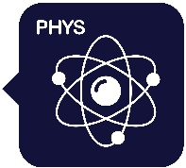
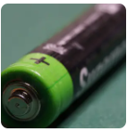
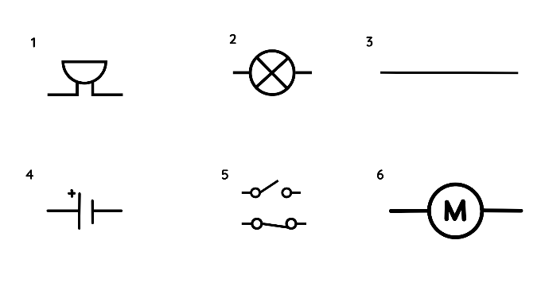
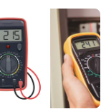
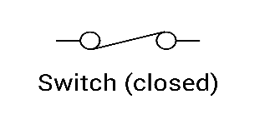
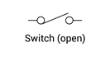
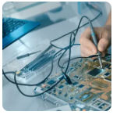
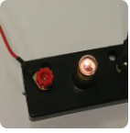
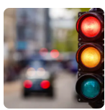
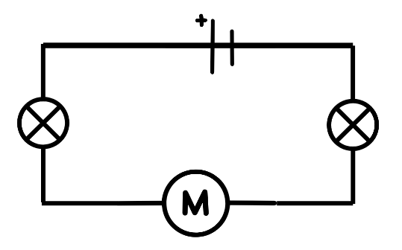
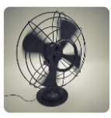
Knowledge Organiser
Year 6 – Electricity
Careers connected to this unit: mechanical engineering technician,
electricity distribution worker, electrical engineer, energy engineer
Lesson Sequence
Key Facts
In a simple series circuit, the current flows from negative to positive. There are no gaps – a complete circuit allows the components to work.
Gaps in the wires or faulty components cause the circuit to be incomplete and the current cannot flow in a complete loop.
Switches can be open or closed and this determines whether the electricity can flow in a complete loop.
Circuit Symbols
buzzer 2. bulb 3. wire
4. cell 5. switch 6. motor
Wires are always drawn with a straight line and using a ruler in scientific diagrams.
Wires are drawn at right angles like this:
1. Describe the parts of an electrical circuit
2. Explore voltage and
its effect on an electrical circuit
3. Apply knowledge to identify and correct problems in a circuit
4. Investigate what affects the output of a circuit
Voltage
Adding more cells (or batteries) to a circuit will make bulbs brighter, buzzers louder and motors faster!
A cell is a single unit of energy; a battery is two or more cells stacked together.
Voltage is the force that pushes the electricity around the circuit; current is the rate at which the electricity travels around the circuit.
The more components in a circuit, the more they share the energy from the cell.
Adding more components to a circuit can mean their outputs decrease.
5. Build a set of traffic lights
6. Apply knowledge of circuits to a real-life problem
1
Developing Experts Copyright 2025 All Rights Reserved

Slide 2

Knowledge Organiser
Year 6 – Electricity
Careers connected to this unit: mechanical engineering technician,
electricity distribution worker, electrical engineer, energy engineer
Rocket Words
component | the individual parts that make up a whole circuit e.g. bulb, buzzer, cell
circuit diagram | scientific drawing of an electrical circuit
voltage | force which pushes the electric current round the circuit; measured in volts and given the symbol V
current | the rate of electricity flowing through a circuit
filament | a thin wire in a light bulb that heats up and produces light when electric current passes through it
output | the amount of something produced (e.g. brightness of a bulb)
insulative | describes something that prevents or resists the flow of electricity or heat
conductive | the ability of a material to allow the flow of electric current
2
Developing Experts Copyright 2025 All Rights Reserved

